Slide 1


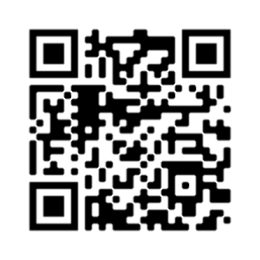
Beautyspot
Toby, Harry, Jack, Shalan, Jason and Artur
Explore Campus
Discover campus’s most beautiful spots.
Powered by AI
Image and facial recognitions.
Achieve Badges
Gain badges for posting the best picture.
Climb the Leaderboard
Compete with students to reach the top.
Connect with People
View peoples profiles.
https://django-deploy-3kpp3.ondigitalocean.app/
Scan me

